Slide 1
Excel Dashboard
Insurance Analytics Dashboard – Built Using Excel
BY GROUP 4
1.EDIGA GOPALA KRISHNA
2.RAHUL KUMAR
3.ABIJEET GOSWAMI
4.PRIYANSHU AGARWAL
5.ALOK
6.SAKEENA

Slide 2
Excel Objectives
Import and clean raw insurance data.
Create pivot tables and KPI formulas.
Build a complete dashboard with Excel charts.

Slide 3
Excel Activities
Data Cleaning:
  Remove blanks, duplicates.
KPI Formulas:
  Cross Sell Ach % = (Achievement / Target) * 100
  Invoice Ach % = (Invoice / Target) * 100
Pivot Tables:
  Yearly meeting counts.
  Opportunities by executive.

Slide 4
Excel Dashboard
Charts used:
  Bar Charts for KPIs.
  Funnel chart for revenue stages.
  Pie chart for product group opportunities.
Excel slicers to filter by Employee Name and Year.

Slide 5
Benefits
Fast to set up and analyze data.
Easy to update and maintain.
Cost-effective with no extra tools required.

Slide 6
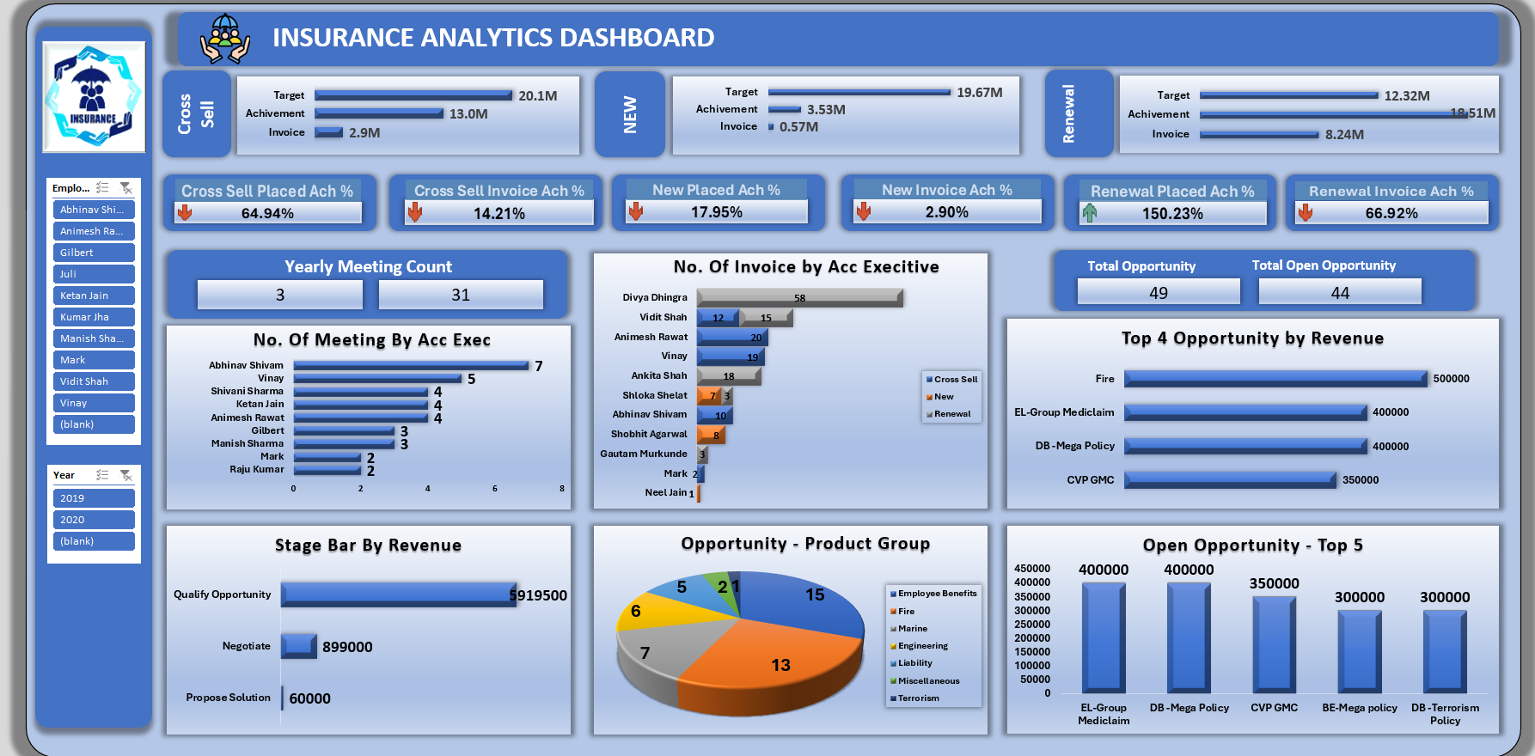

Slide 7
Tableau Dashboard
Insurance Analytics Dashboard – Built Using Tableau

Slide 8
Tableau Objectives
Create interactive dashboards for insurance KPIs.
Visual storytelling to track policies and opportunities.

Slide 9
Tableau Visuals
Charts Built:
  Bar charts for Cross Sell, New, and Renewal.
  Funnel chart for sales stage by revenue.
  Pie chart for product group.
Filters:
  Employee Name
  Year/Date Range

Slide 10
Tableau Benefits
Easy drag-and-drop visualizations.
Live, interactive exploration of data.
Excellent for storytelling and presentations.

Slide 11
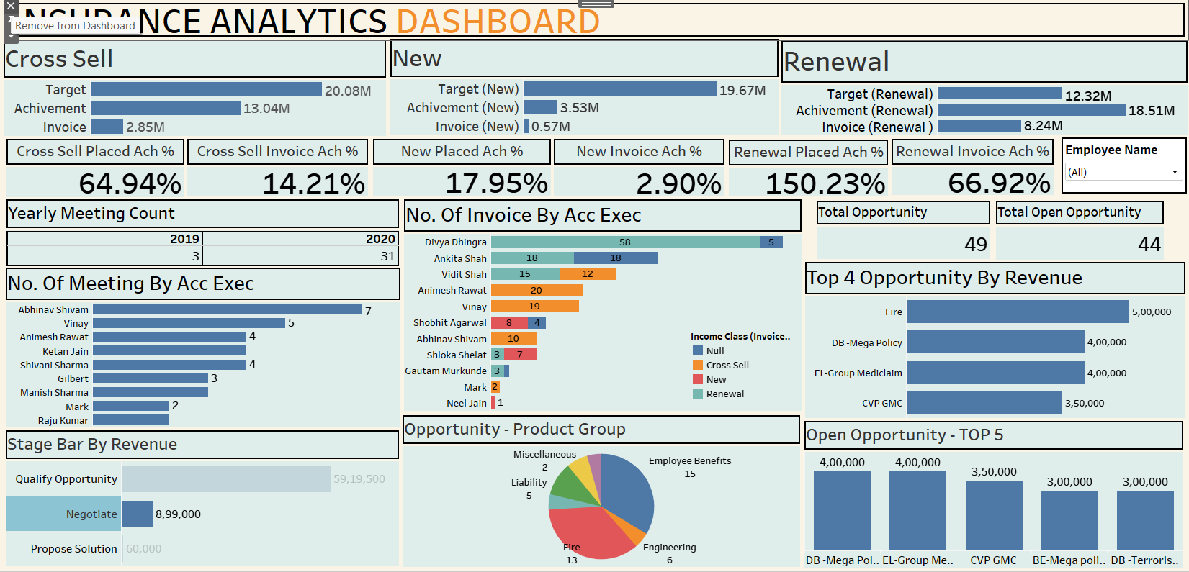

Slide 12
Power BI Dashboard
Insurance Analytics Dashboard – Built Using Power BI

Slide 13
Power BI Objectives
Automate KPI calculations using DAX measures.
Create interactive dashboard with filters and slicers.

Slide 14
Power BI Features
DAX Measures:
Achievement % = DIVIDE(SUM(Achievement), SUM(Target)) * 100
Slicers:
  Employee Name
  Year
Visuals:
  KPI cards
  Bar chart: Top 5 opportunities
  Funnel chart for sales stages

Slide 15
Benefits
Easy to maintain and scale.
Real-time reporting.
Ideal for leadership decision-making.

Slide 16
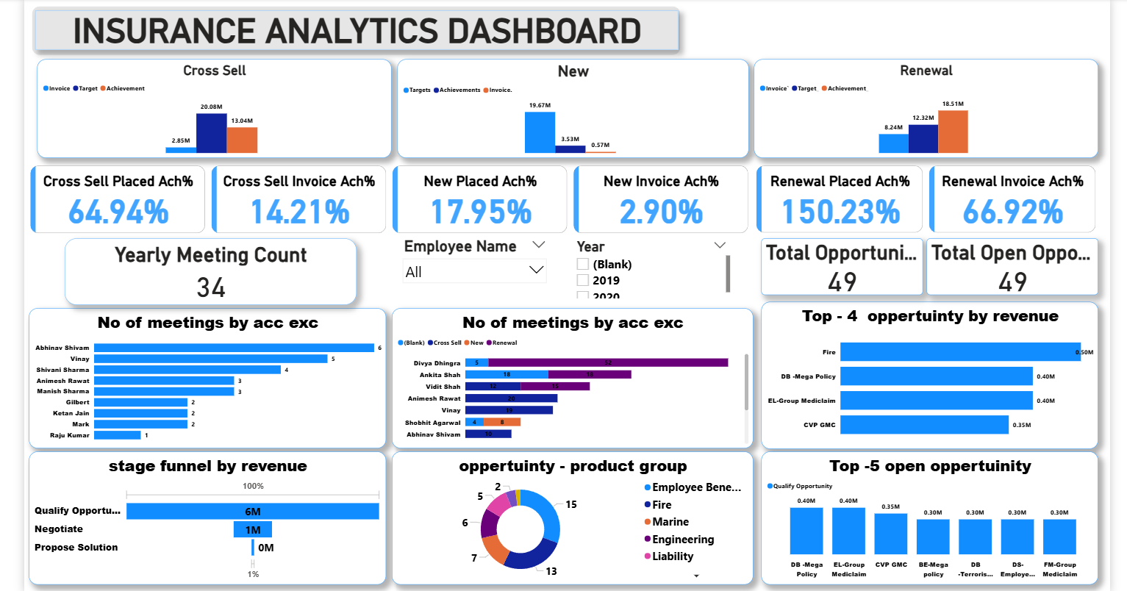

Slide 17
Insurance Analytics – Built Using SQL QUERIES
Goal: Create the dashboard entirely using SQL queries and views

Slide 18
SQL Objectives
Extract raw data from multiple tables:
  Policy, Customer, Revenue, Employees.
Perform KPI calculations:
  Cross Sell %, Renewal %, Invoice %.
Identify top opportunities by revenue.

Slide 19
SQL Design
Created tables & views:
  Opportunities table
  Meetings table
  Renewal tracking table
Sample KPI query:
SELECT policy_type,
SUM(achievement)/SUM(target)*100 AS Achievement_Percent
FROM insurance_data
GROUP BY policy_type;

Slide 20
SQ Output:
Used only SQL tools:
  SQL queries generate reports.
  Exported results as tables.
Data presented via SQL Server reporting.

Slide 21
Key Benefits
Single source of truth.
High performance for large datasets.
Automates calculations with scheduled queries.

